Slide 1
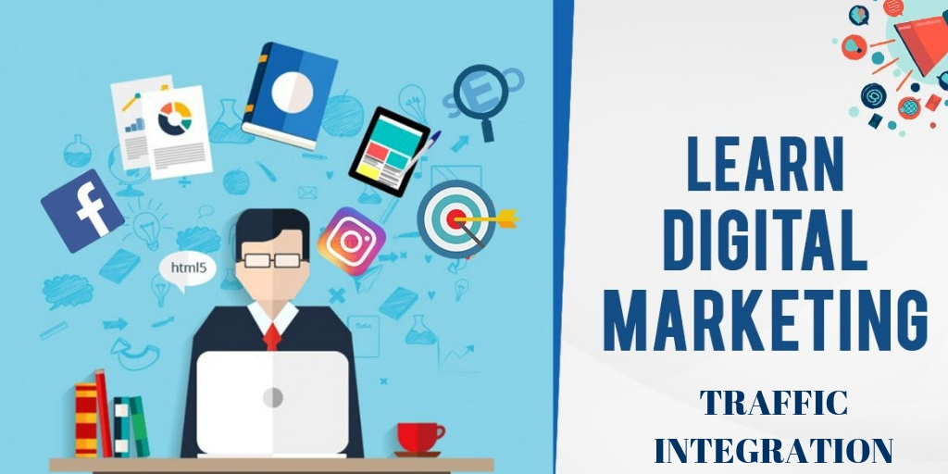
Best Digital Marketing Company in Coimbatore

Slide 2
Introduction
The crazy bunch of innovative minds at Traffic Integration began their journey of acquisition the brands digitally before several might even trust doing the digital means. At Traffic Integration, our priority is to supply our purchaser’s unequalled expertise through tailor-fit digital solutions and that’s why we have a tendency to continuously place ourselves within the customer’s shoe to higher perceive the vision, mission, and worth of their whole and business.

Slide 3
Search Engine optimization (SEO) Training in Coimbatore
‘Just Google it’ could be a phrase that created tens and thousands of companies of all shapes and sizes to vie within the ‘World of Keywords’ to air the primary page of Google! At Traffic Integration, we provide the foremost effective computer program optimization ways and this is often the explanation we have a tendency to be thought-about the most effective SEO service supplier in Coimbatore.

Slide 4
Search Engine Marketing (SEM) Training in Coimbatore
Traffic Integration’s holistic model of SEM services is devised in such the simplest way that the 2 main disciplines of SEM, computer program optimization (SEO) and Pay Per Click (PPC) are complementary to every different in giving the higher results. Different services we offer are ad copy and SEO copywriting, creation of landing pages and metric analysis exploitation net analytics tools and applications.

Slide 5
Social Media Marketing (SMM) Training in Coimbatore
Social Media Marketing has become a lot of crucial in fast the success stories of the brands within the previous few years.
Be it whole awareness or lead generation or perhaps unleashing a infectious agent Marketing campaign, at Traffic Integration, our strategists can continuously check that to attain your business objectives by chase the KPI’s from time to time.
As a Social Media Marketing company in Coimbatore, we have a tendency to be also keen on keeping the correct balance between the paid and organic techniques on completely different social platforms like Facebook, Twitter, Instagram, Google+ etc. With our paid advertising ways, you can:
Build audience base
Increase Social Engagement
Drive traffic to your web site
Optimize your ads for conversions
Increase whole awareness

Slide 6
Conclusion
We are a Digital Marketing Company of our own kind specialized in delivering web Advertising Solutions that features Conversion optimization, Social promoting, show Advertising, whole Management, SEO, SEM, etc.
Traffic Integration could be a digital Marketing company giving clear services in Coimbatore. Be able to set your digital promoting campaigns enthusiastically with the sharpest minds within the trade. Get in reality, we'd like to hear from you
Email - info@trafficintegration.com
Call : +(91) 979 180 4290

